Slide 1
R 211753Z NOV 01
FM COMDT COGARD WASHINGTON DC//G-OPR//TO AIG 11929
BT
UNCLAS //N16101//
SUBJ: ADDITIONAL SAR FLARE GUIDANCE
A. APPENDIX INDIA OF THE COAST GUARD ADDENDUM TO THE NATIONAL SAR MANUAL, COMDTINST M16130.2BB. SUPPLEMENT TO APPENDIX INDIA OF THE COAST GUARD ADDENDUM TO THE NATIONAL SAR MANUAL, COMDTINST M16130.2B
1. THIS MSG PROVIDES FURTHER GUIDANCE TO SAR CONTROLLERS AND PERSONNEL RESPONDING TO FLARE SIGHTINGS.
2. THE POLICIES AND GUIDANCE PROVIDED IN REFS A AND B, REMAIN IN EFFECT.
3. WHEN PREPARING A FIRST LIGHT SEARCH, SAR CONTROLLERS SHOULD FORMULATE A DRIFT SEARCH AREA USING THE "LEEWARD" SIDE OF THE FLARE PLOT. TAKE THE LEEWARD MINIMUM EDGE POSITION AND THE LEEWARDMAXIMUM EDGE POSITION AND DRIFTING THIS AS TWO LINE/AREA AMS SOLUTIONS.
4. THIS DRIFTED SIDE THEN REPRESENTS THE FAR SIDE OF THE NEW SEARCH AREA. THOUGH THE SAR CONTROLLER IS SELECTING POSITIONS ALONG THE OUTER EDGE OF THE FLARE CONE, THIS IS NOT TO BE SOLVED AS A POINT PROBLEM. THE OBJECTIVE IS TO SOLVE FOR THE AREA OF THE FLARE CONE AND WHERE IT WILL TRAVEL TO BY FIRST LIGHT. IN THE ABSENCE OF LOCAL INFORMATION ON PROBABLE TARGETS, YOU SHOULD DRIFT A LIGHT DISPLACEMENT/NO DROGUE VESSEL. THIS WILL ACCOUNT FOR BOTH A 15-25 FOOT VESSEL AND A 4 PERSON RAFT. BEAR IN MIND THAT THE WINDS AND CURRENT WILL NOT ALWAYS GIVE A CLEAR "LEEWARD" EDGE WITH JUST TWO POSITIONS.
5. IN A CASE WHERE THE ENVIRONMENTAL ELEMENTS PUSH THROUGH THE FLARE CONE AT A 45 DEGREE ANGLE, IT COULD REQUIRE THAT THREE POSITIONS ON THE MINIMUM AND MAXIMUM LIMITS OF THE FLARE CONE BE DRIFTED TO CLEARLY DEFINE A MAXIMUM DRIFTED AREA.
6. IF THE ENVIRONMENTAL ELEMENTS WILL BE THE SAME FOR EACH POINTCHOSEN, THEN ONLY THE NEW POSITION NEEDS TO BE IDENTIFIED. THE SARCONTROLLER SHOULD BE AWARE THAT IN SOME CASES, LIKE A PARACHUTE FLARE LOW ON THE HORIZON, THAT ONE END OF THE CONE COULD END IN THE COASTAL ENVIRONMENT WHILE THE OTHER END IS ACTUALLY IN THE OCEANIC ENVIRONMENT. APPLY THE PROPER ENVIRONMENTAL VECTORS FOR EACH POSITION.
7. THIS ADDITIONAL GUIDANCE WILL BE INCORPORATED IN FUTURE ADDITIONS TO REF A.

Slide 2
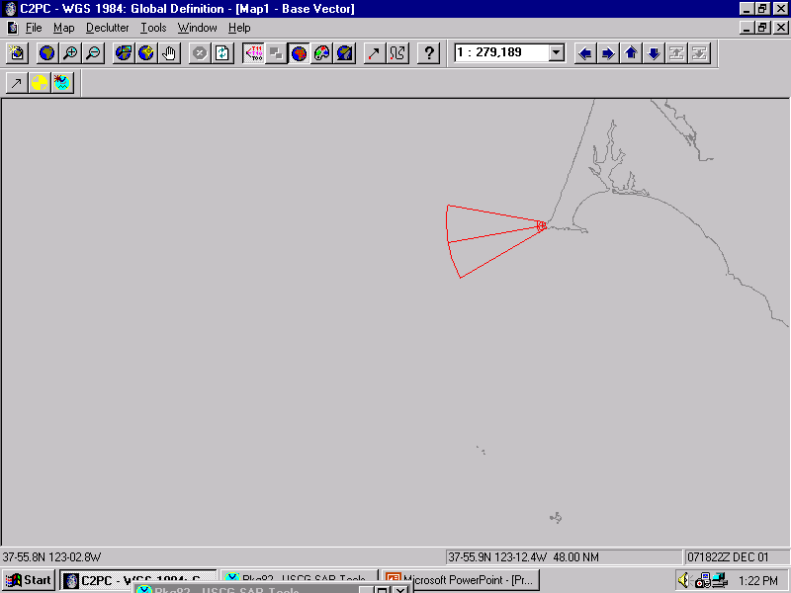
Initial Flare Cone Plot

Slide 3
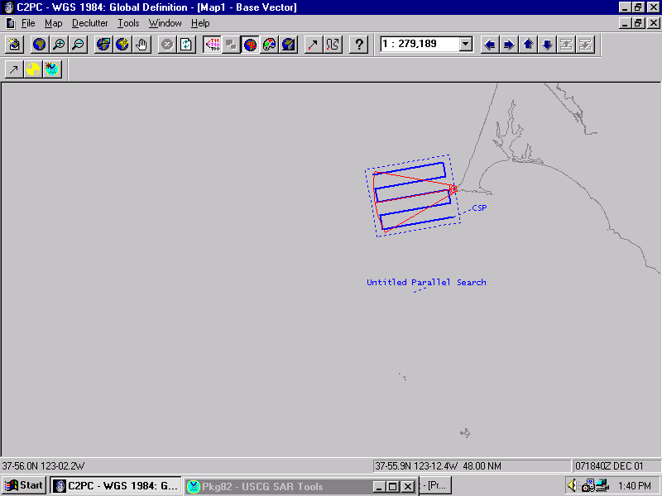
Initial Flare Search Pattern
Taking into account a 10% increase on the dimensions for safety error.

Slide 4
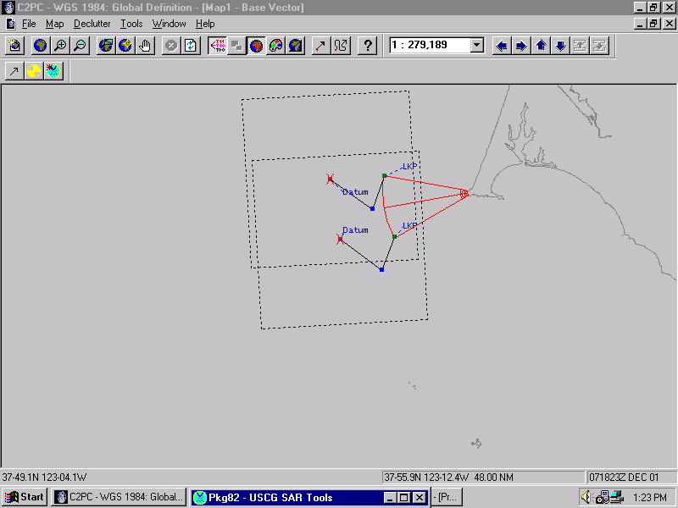
Drifted Flare Cone
(Sample #1)
Total drift is to the “west”… only the Leeward sides need to be drifted.

Slide 5
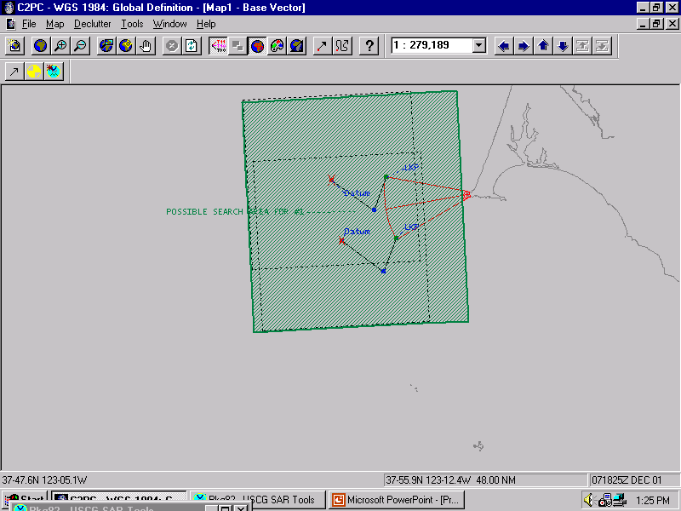
Drifted Flare Cone
Search Area
(Sample #1)
Optional
search area.
SMC decision making comes into play here… do you have a reason to search the original cone area not included in your drifted search area?
Example: Is it possible for a boat to anchor in that area?

Slide 6
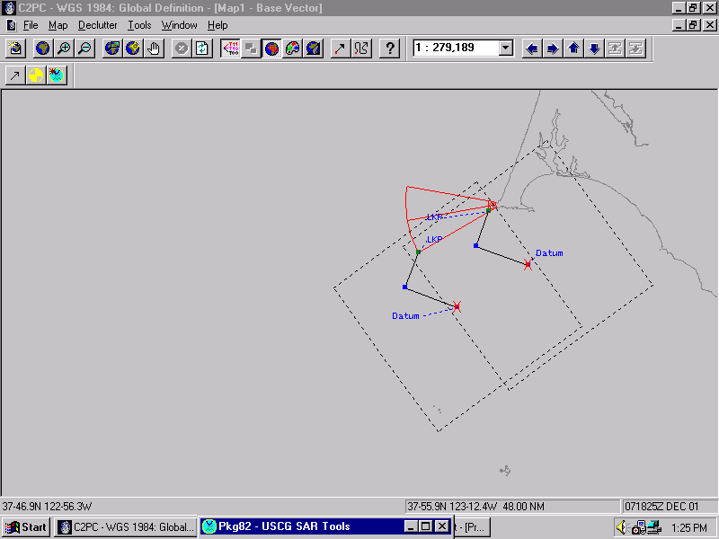
Drifted Flare Cone
(Sample #2)
Total drift is to the “south-east”…
Again, only the Leeward sides need to be drifted.

Slide 7
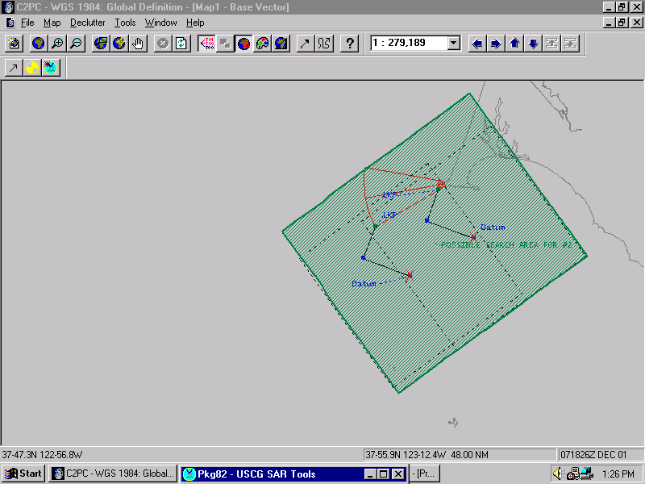
Drifted Flare Cone
Search Area
(Sample #2)
Same as sample #1.
Again, SMC decision making comes into play here.

Slide 8
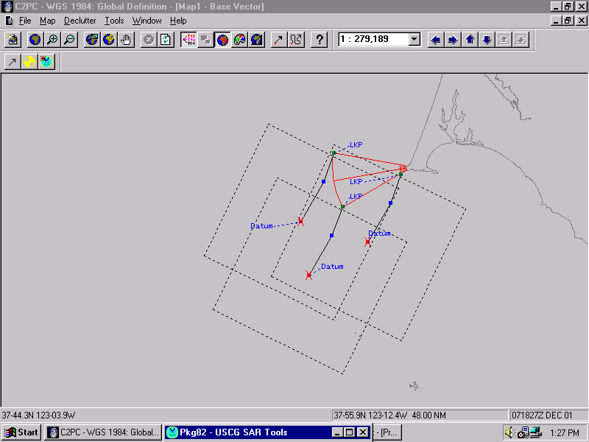
Drifted Flare Cone
(Sample #3)
Total drift is to the “south-west”…
Again, only the Leeward sides need to be drifted.
In this case, you have 3 drifts.

Slide 9
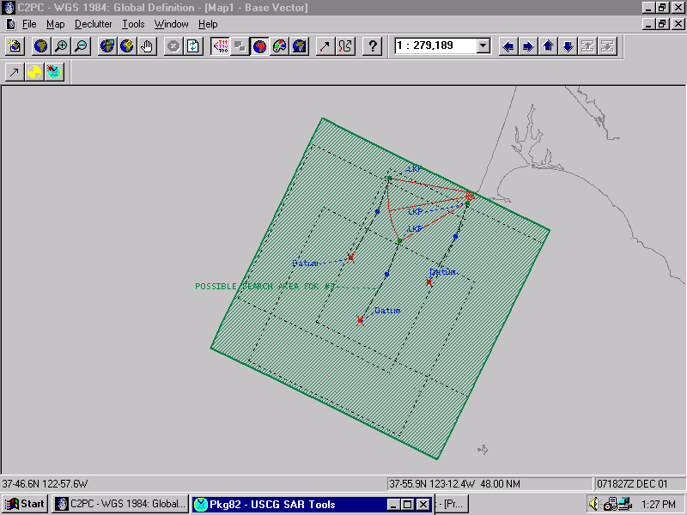
Drifted Flare Cone
Search Area
(Sample #3)
Same as samples #1&2.
Again, SMC decision making comes into play here.

Slide 10
The key to drifting a Flare Plot, is to drift an “Area”.
You are drifting an “Area” because you don’t have a “single point” to start your drift from.
What you are really doing is drifting the corners of an “Area”.
Using the “Line/Area” button on page 1 of your AMS will give you 2 or 3 Downwind Leeway drifts depending on your total drift direction.
Most of the time, your Leeway will be the dominant factor, but you may run into occasions where the wind is light enough to have the sea currents or tidal currents become the dominant factor.

Slide 11
Remember, when creating a drifted flare plot, the “art” side of search planning is paramount. Consider all aspects of your situation… did a fishing tournament, regatta or some other event take place earlier that day which would lead you to believe you may be looking for a certain type of search object?
For example…
Search Object: If you have good reason to believe you may be searching for a certain object (example: You had a major fishing tournament in the area that day consisting of 19-24ft boston whalers.), then you may want to consider that as your search object. If you are searching off-shore where most of your smaller craft would not be, you may want to consider a liferaft.
If so, then plot the following:
Survival Craft – Maritime Liferafts – Shallow ballast system & Canopy – No drogue
If you have NO information to lead you one way or the other, go with:
Power vessels – Sport boats – Cuddy cabin – Modified V-hull
(This will produce a drift which will encompass “most” search objects.)

